Slide 1
DATA SCIENCE BOOTCAMP
Session 8: EDA – Data Preparation
Copyright © 2020 Exceed Philippines. All rights reserved

Slide 2
SESSION 8 OUTLINE
MACHINE LEARNING PROCESS RECAP
DESCRIPTIVE STATISTICS
VERIFYING DATA QUALITY: COMMON ISSUES
CONVERTING: CATEGORY TO NUMBERS
SCALING
Copyright © 2020 Exceed Philippines. All rights reserved

Slide 3
SESSION 8 OUTLINE
MACHINE LEARNING PROCESS RECAP
DESCRIPTIVE STATISTICS
VERIFYING DATA QUALITY: COMMON ISSUES
CONVERTING: CATEGORY TO NUMBERS
SCALING
Copyright © 2020 Exceed Philippines. All rights reserved

Slide 4
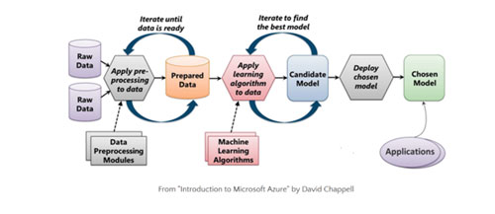
MACHINE LEARNING PROCESS
Copyright © 2020 Exceed Philippines. All rights reserved
Google Images: “machine learning process”

Slide 5
SESSION 8 OUTLINE
MACHINE LEARNING PROCESS RECAP
DESCRIPTIVE STATISTICS
VERIFYING DATA QUALITY: COMMON ISSUES
CONVERTING: CATEGORY TO NUMBERS
SCALING
Copyright © 2020 Exceed Philippines. All rights reserved

Slide 6
DESCRIPTIVE STATISTICS
Descriptive statistics are brief informational coefficients that summarize a given data set, which can be either a representation of the entire population or a sample of a population. Descriptive statistics are broken down into measures of central tendency and measures of variability (spread)
Copyright © 2020 Exceed Philippines. All rights reserved
https://www.investopedia.com/

Slide 7
DESCRIPTIVE STATISTICS
Descriptive statistics are brief informational coefficients that summarize a given data set, which can be either a representation of the entire population or a sample of a population. Descriptive statistics are broken down into measures of central tendency and measures of variability (spread)
Copyright © 2020 Exceed Philippines. All rights reserved
https://www.investopedia.com/

Slide 8
DESCRIPTIVE STATISTICS
.head()
.tail()
.shape
.columns
.info()
.dtypes
.describe()
Copyright © 2020 Exceed Philippines. All rights reserved

Slide 9
SESSION 8 OUTLINE
MACHINE LEARNING PROCESS RECAP
DESCRIPTIVE STATISTICS
VERIFYING DATA QUALITY: COMMON ISSUES
CONVERTING: CATEGORY TO NUMBERS
SCALING
Copyright © 2020 Exceed Philippines. All rights reserved

Slide 10
DATA QUALITY COMMON ISSUES
Improper Labels
Missing Values
Incorrect Formats
Duplicated Data
Incorrect Spelling
Outliers
Copyright © 2020 Exceed Philippines. All rights reserved

Slide 11
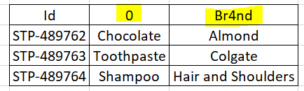
DATA QUALITY COMMON ISSUES
Improper Labels
Missing Values
Incorrect Formats
Duplicated Data
Incorrect Spelling
Outliers
0 -> Product
Br4nd -> Brand
Copyright © 2020 Exceed Philippines. All rights reserved

Slide 12
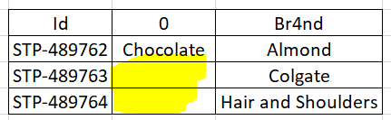
DATA QUALITY COMMON ISSUES
Improper Labels
Missing Values
Incorrect Formats
Duplicated Data
Incorrect Spelling
Outliers
* drop the column or handle using other values – mean, mode
Copyright © 2020 Exceed Philippines. All rights reserved

Slide 13
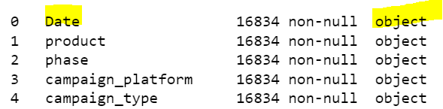
DATA QUALITY COMMON ISSUES
Improper Labels
Missing Values
Incorrect Formats
Duplicated Data
Incorrect Spelling
Outliers
Convert to datetime instead of object
Convert to numbers instead of object
Copyright © 2020 Exceed Philippines. All rights reserved

Slide 14
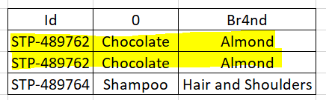
DATA QUALITY COMMON ISSUES
Improper Labels
Missing Values
Incorrect Formats
Duplicated Data
Incorrect Spelling
Outliers
.duplicate()
Copyright © 2020 Exceed Philippines. All rights reserved

Slide 15
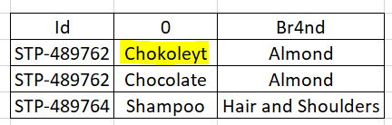
DATA QUALITY COMMON ISSUES
Improper Labels
Missing Values
Incorrect Formats
Duplicated Data
Incorrect Spelling
Outliers
* Replace the values with correct spelling
Copyright © 2020 Exceed Philippines. All rights reserved

Slide 16
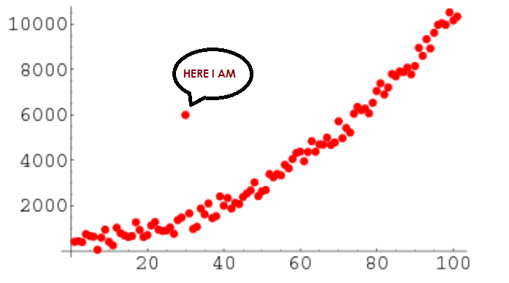
DATA QUALITY COMMON ISSUES
Improper Labels
Missing Values
Incorrect Formats
Duplicated Data
Incorrect Spelling
Outliers
Copyright © 2020 Exceed Philippines. All rights reserved
Google Images: “outliers”
Notes:
A value that "lies outside" (is much smaller or larger than) most of the other values in a set of data.

Slide 17
SESSION 8 OUTLINE
MACHINE LEARNING PROCESS RECAP
DESCRIPTIVE STATISTICS
VERIFYING DATA QUALITY: COMMON ISSUES
CONVERTING: CATEGORY TO NUMBERS
SCALING
Copyright © 2020 Exceed Philippines. All rights reserved

Slide 18


CONVERTING: CATEGORY TO NUMBERS
Remember, a computer can only understand 1s and 0s
Copyright © 2020 Exceed Philippines. All rights reserved
Google Images: “computer 1 and 0”
Notes:
A value that "lies outside" (is much smaller or larger than) most of the other values in a set of data.

Slide 19
SESSION 8 OUTLINE
MACHINE LEARNING PROCESS RECAP
DESCRIPTIVE STATISTICS
VERIFYING DATA QUALITY: COMMON ISSUES
CONVERTING: CATEGORY TO NUMBERS
SCALING
Copyright © 2020 Exceed Philippines. All rights reserved

Slide 20
SCALING
Feature Scaling is a technique to standardize the independent features present in the data in a fixed range.
It is performed during the data pre-processing to handle highly varying magnitudes or values or units.
Copyright © 2020 Exceed Philippines. All rights reserved
https://www.geeksforgeeks.org/
Notes:
A value that "lies outside" (is much smaller or larger than) most of the other values in a set of data.

Slide 21
SCALING
Feature Scaling is a technique to standardize the independent features present in the data in a fixed range.
It is performed during the data pre-processing to handle highly varying magnitudes or values or units.
Copyright © 2020 Exceed Philippines. All rights reserved
https://www.geeksforgeeks.org/
Notes:
A value that "lies outside" (is much smaller or larger than) most of the other values in a set of data.

Slide 22
DATA SCIENCE BOOTCAMP
Session 8: EDA – Data Preparation
Copyright © 2020 Exceed Philippines. All rights reserved

